Slide 1
Transposons
spreads
carry
helps competion and defense on
The switch to particle lifestyle
Defense
mechanism
cassettes
A deep-ocean microbial community

Slide 2
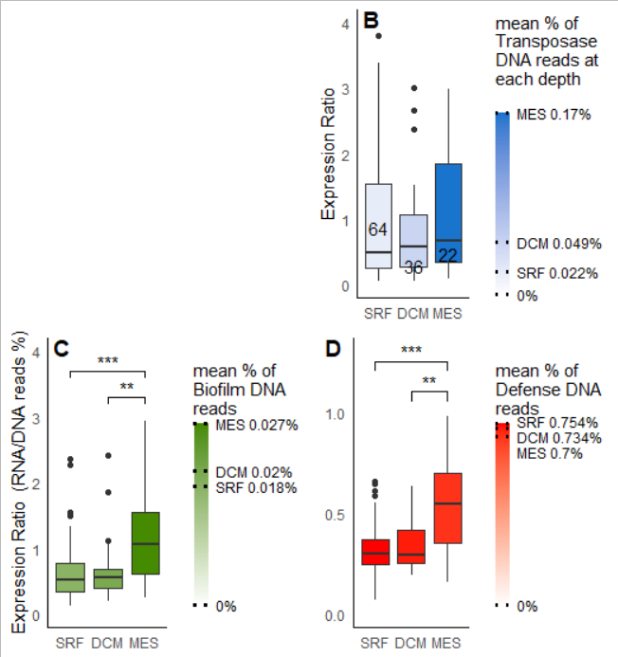

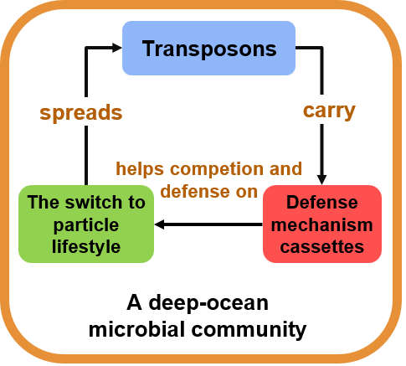

Slide 3
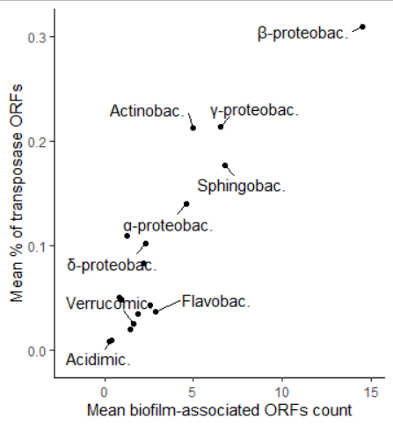
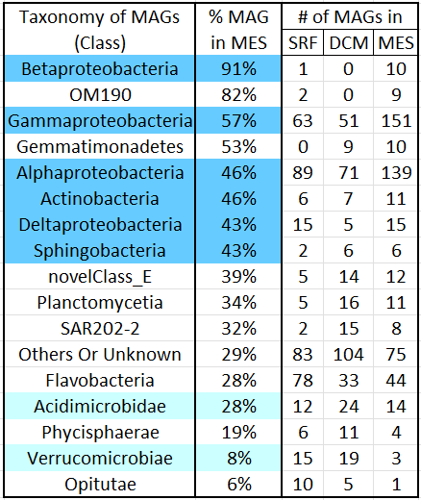








Slide 4
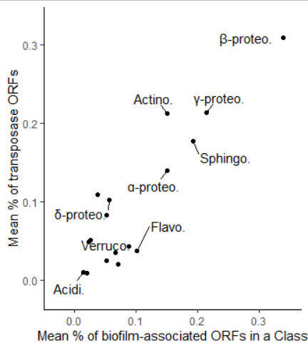







Slide 5
